Slide 1
Embedded System Lab
December Presentation
Task 1-5
Team F1
Ye Htet Kyaw, Md Asifur Rahman Saikot, Tafon Sjinkwe Boris

Slide 2
TASK 1
Traffick Light System

Slide 3
Class Diagram

Slide 4
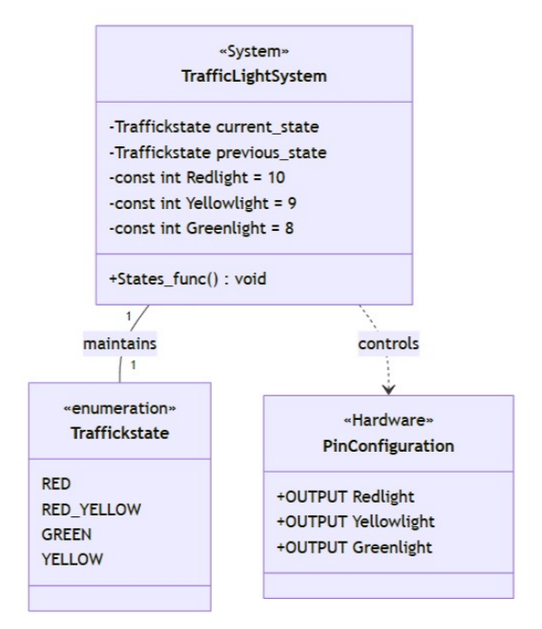

Slide 5
State Machine Diagram

Slide 6
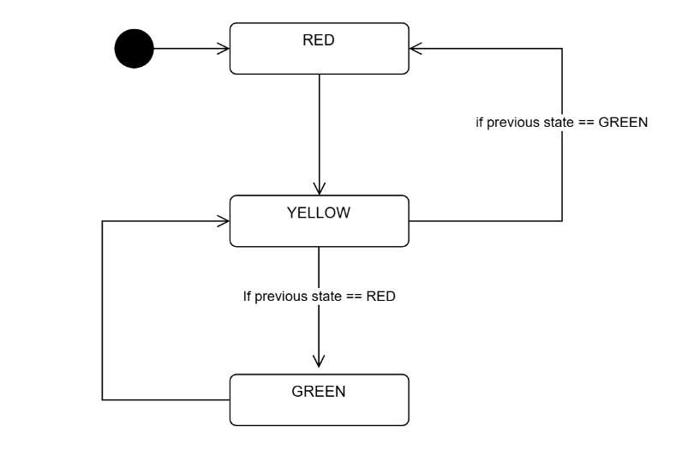

Slide 7
Code

Slide 8
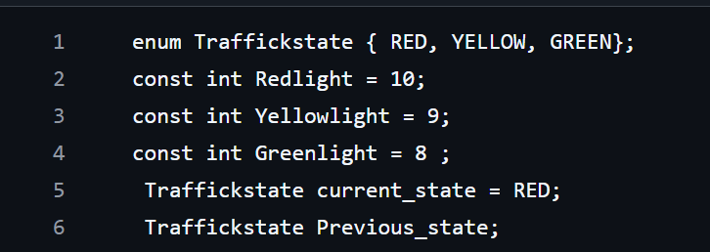

Slide 9
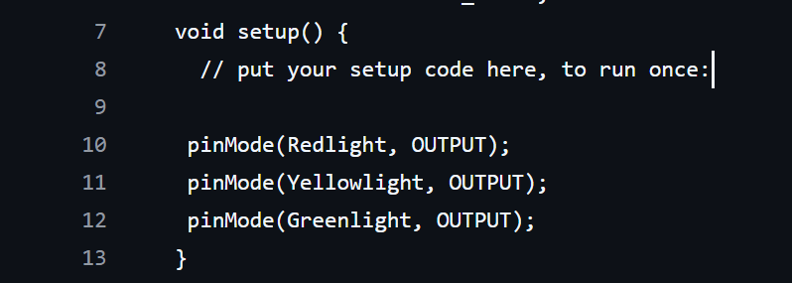

Slide 10
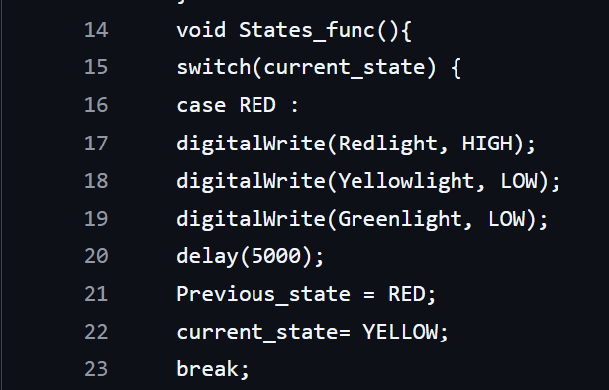

Slide 11
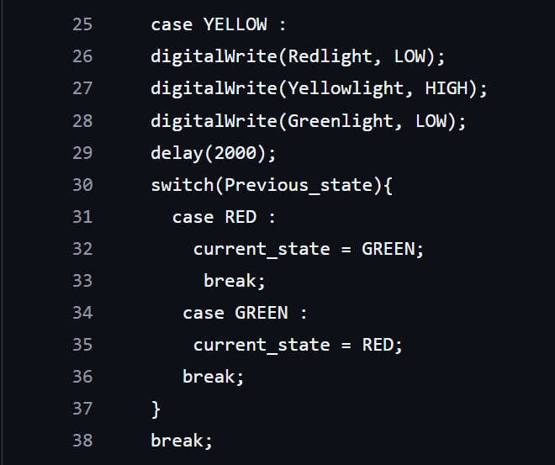

Slide 12
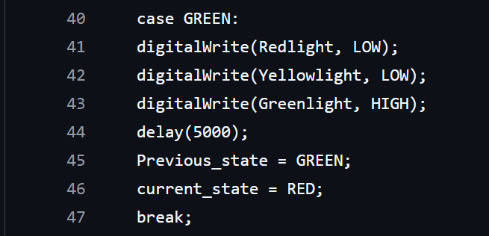

Slide 13
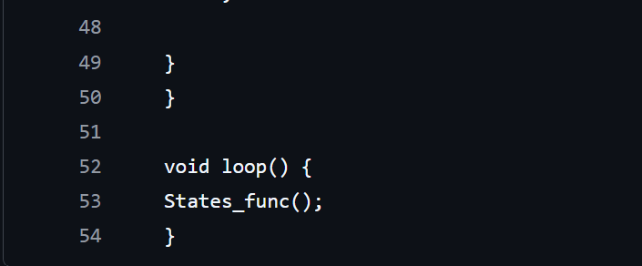

Slide 14
TASK 3
Implementing traffic light on arduino

Slide 15
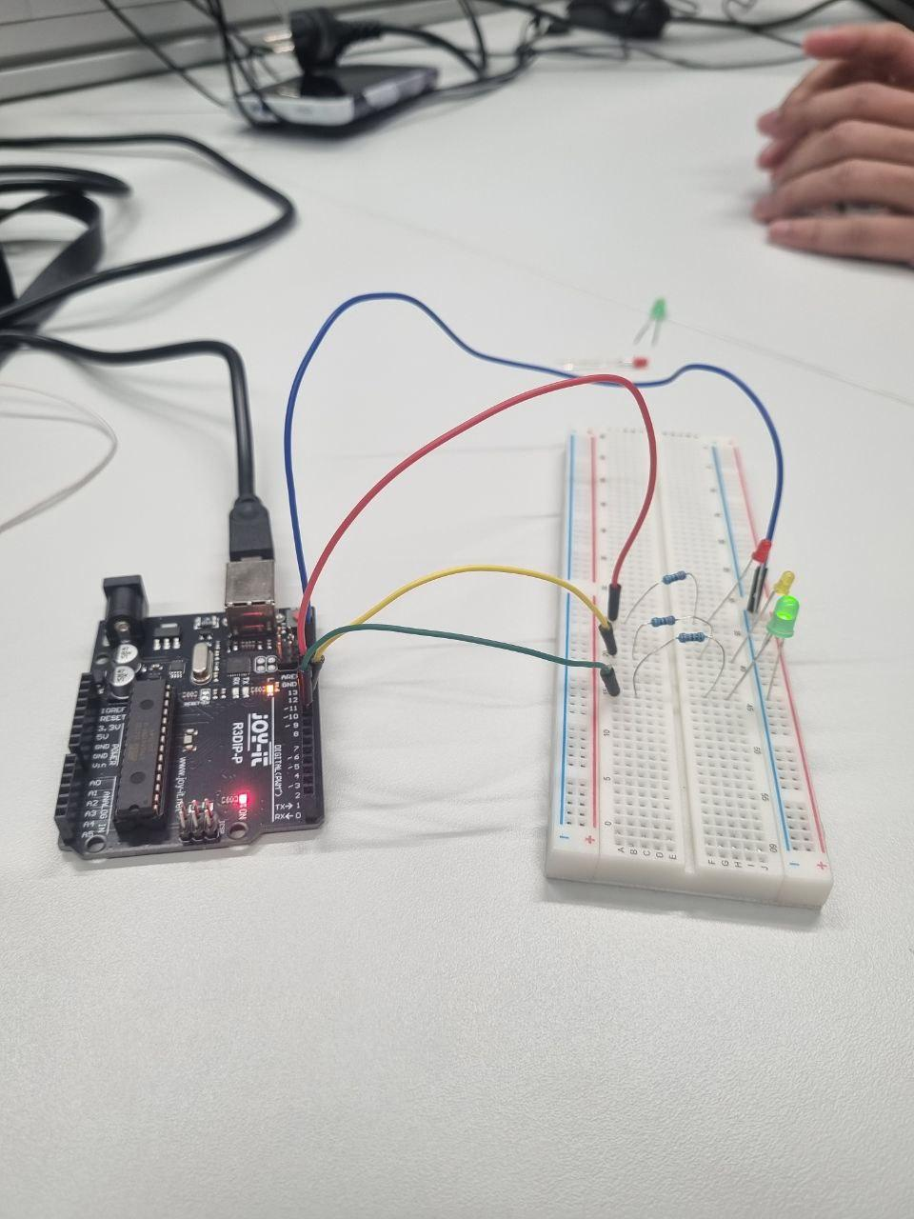

Slide 16
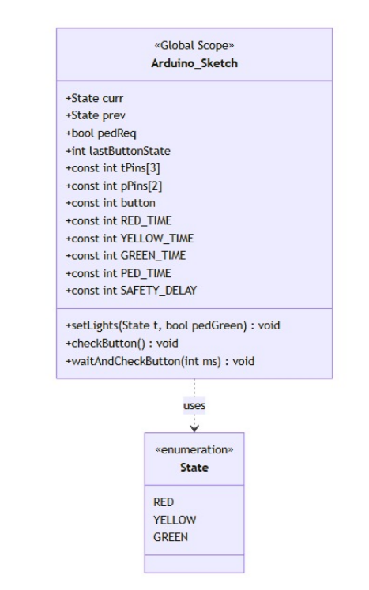
Task-2&4
Class Diagram

Slide 17
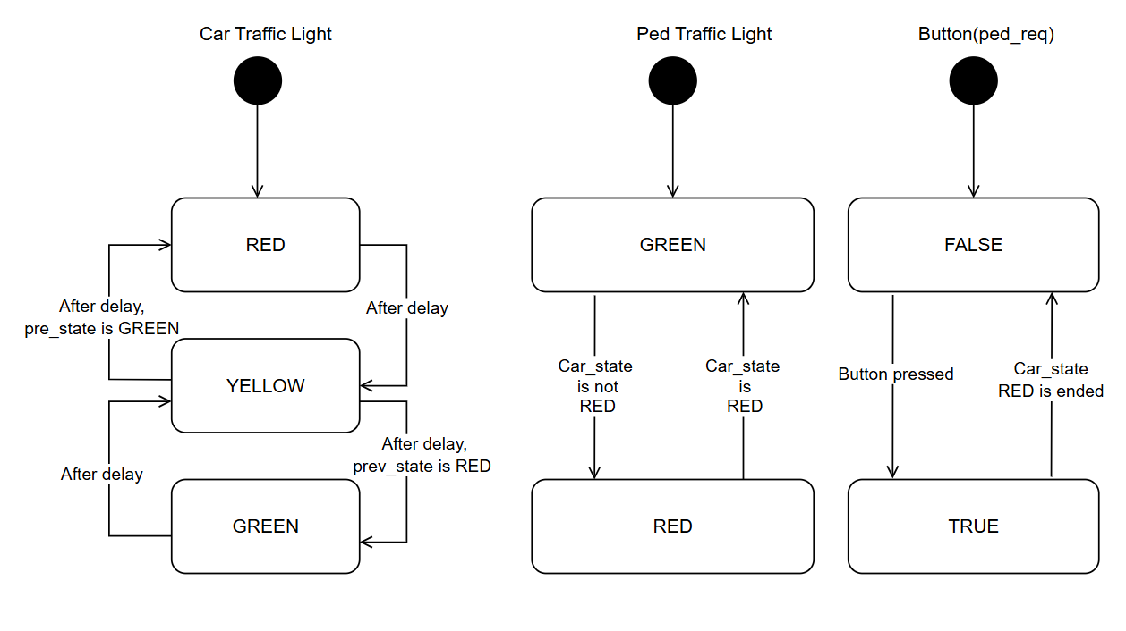
State Machine Diagram Task 2

Slide 18
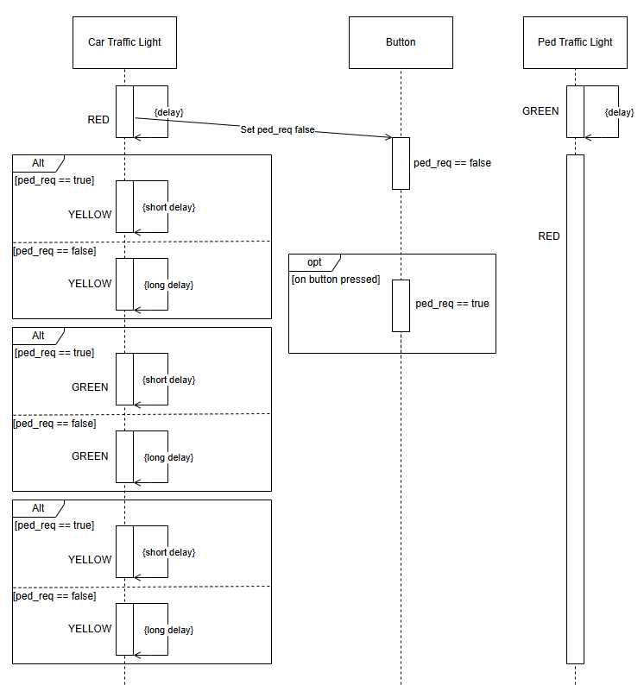
Sequence Diagram Task 2

Slide 19

Important Blocks of the Code
Block-1:State Machine Definition

Slide 20
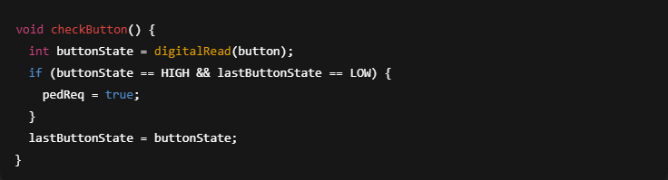
Block-2: Button Detection

Slide 21
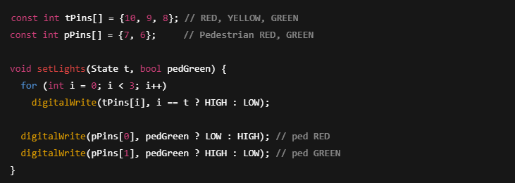
Block-3: Traffic & Pedestrian Control

Slide 22
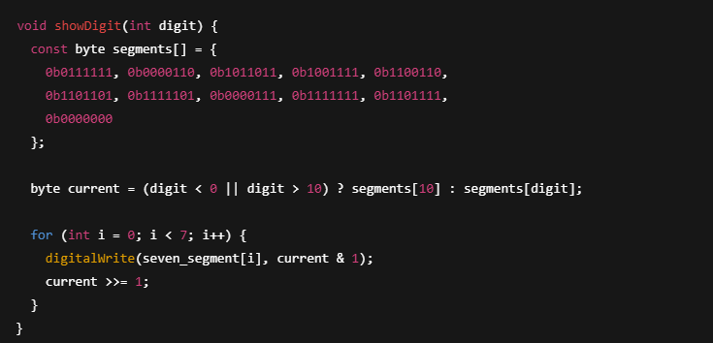
Block-4: Seven-Segment Display Output (Task-4)

Slide 23
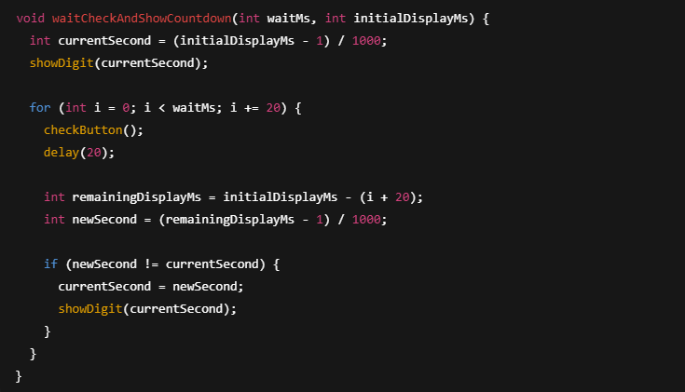
Block-5: 7seg Display Logic

Slide 24
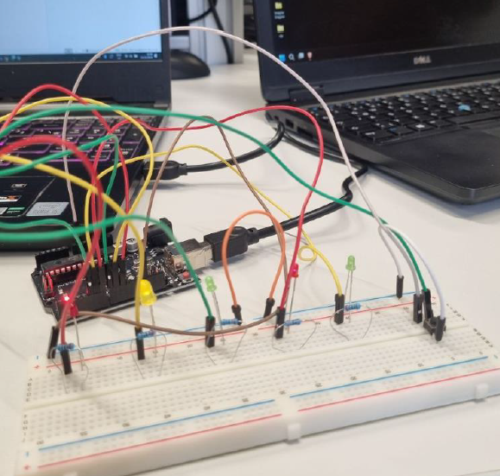
Task-2&4 Implementation

Slide 25
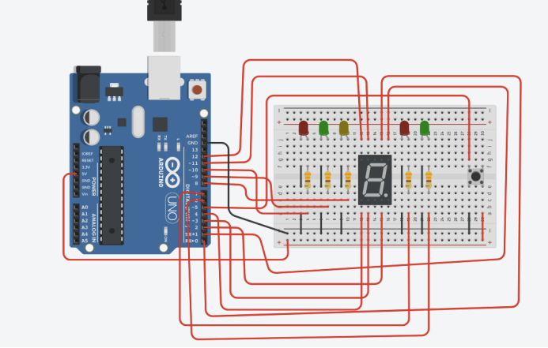
TinkerCAD Simulation

Slide 26
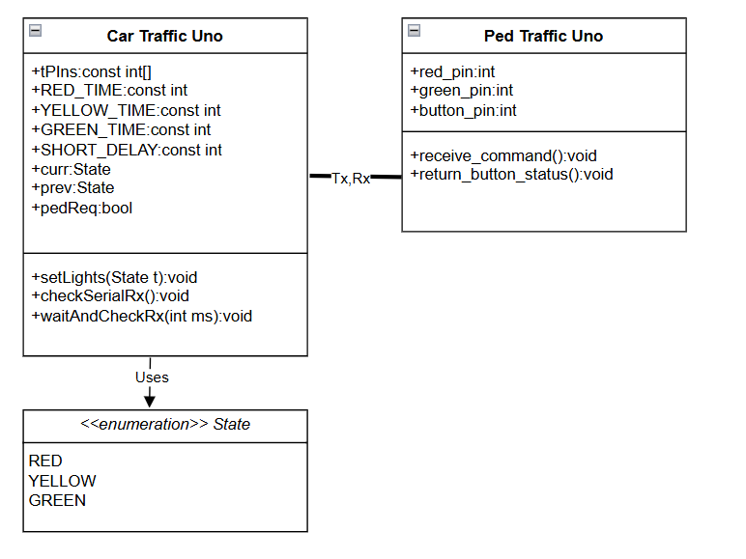
Task 5 Traffic Light System with two µCs
Class Diagram

Slide 27
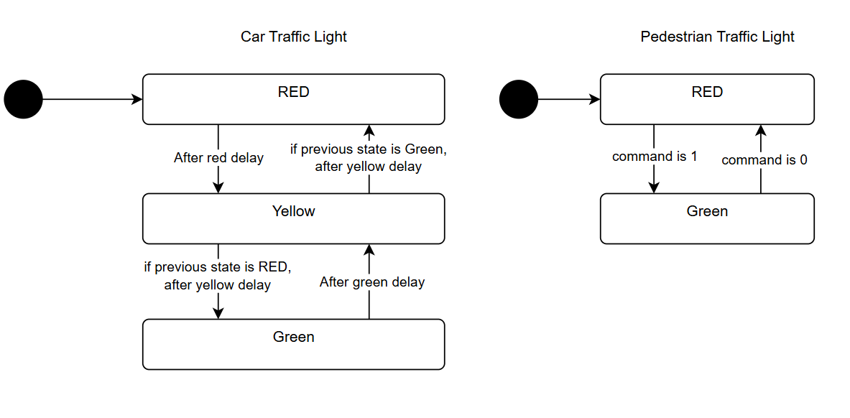
Task 5 Traffic Light System with two µCs
State Machine diagram

Slide 28
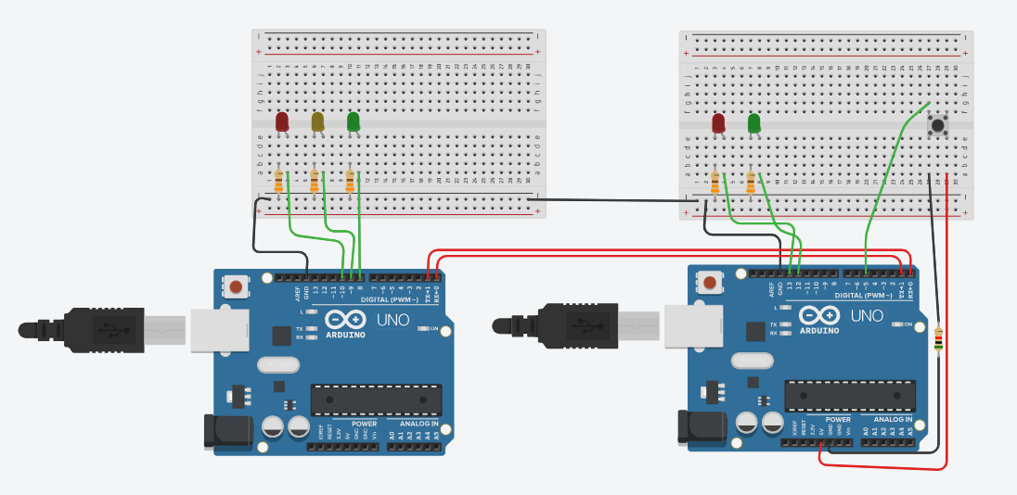
Task 5 Traffic Light System with two µCs
Tinkercad Simulation

Slide 29
Task 5 Traffic Light System with two µCs (Car code blocks)
enum State {RED, YELLOW, GREEN};
void setLights(State t);
const int tPins[] = {10, 9, 8};
const int RED_TIME = 3000;
const int YELLOW_TIME = 2000;
const int GREEN_TIME = 3000;
const int SHORT_DELAY = 800;
State curr = RED, prev;
bool pedReq = false;
void checkSerialRx() {
if (Serial.available() > 0) {
char received = Serial.read();
if (received == 'P'){
pedReq = true;
}
}
}
void waitAndCheckRx(int ms) {
for (int i = 0; i < ms; i += 20)
{
checkSerialRx();
if(pedReq){
delay(SHORT_DELAY);//end sooner if P is detact
return;
}
delay(20);
}
}
void setLights(State t){
for (int i = 0; i < 3; i++)
digitalWrite(tPins[i], i == t ? HIGH : LOW);
}

Slide 30
Task 5 Traffic Light System with two µCs (Car code blocks)
void setup(){
for (int i = 0; i < 3; i++) pinMode(tPins[i], OUTPUT);
Serial.begin(9600);
setLights(RED);
}
case YELLOW:
setLights(YELLOW);
Serial.write('0');
waitAndCheckRx(YELLOW_TIME);
curr = (prev == RED) ? GREEN : RED;
break;
case GREEN:
setLights(GREEN);
Serial.write('0');
waitAndCheckRx(GREEN_TIME);
prev = GREEN;
curr = YELLOW;
break;
}
}
void loop(){
switch (curr){
case RED:
setLights(RED);
prev = RED;
Serial.write('1');
delay(RED_TIME);
pedReq = false;
Serial.write('0');
curr = YELLOW;
break;

Slide 31
Task 5 Traffic Light System with two µCs (Ped code blocks)
const int red_pin = 13;
const int green_pin = 12;
const int button_pin = 5;
void receive_command(){
if (Serial.available() > 0) {
char command = Serial.read();
if (command == '1') {
digitalWrite(red_pin, LOW);
digitalWrite(green_pin, HIGH);
}
else if (command == '0') {
digitalWrite(red_pin, HIGH);
digitalWrite(green_pin, LOW);
}
}
}
void setup(){
pinMode(red_pin, OUTPUT);
pinMode(green_pin, OUTPUT);
pinMode(button_pin, INPUT);
Serial.begin(9600);
digitalWrite(red_pin, HIGH);
digitalWrite(green_pin, LOW);
}
void return_button_status(){
if (digitalRead(button_pin) == HIGH) {
Serial.write('P');
delay(100);
}
}
void loop(){
receive_command();
return_button_status();
}

Slide 32
Thanks For Your Attention!
Any Question?
Team F1
Ye Htet Kyaw, Md Asifur Rahman Saikot, Tafon Sjinkwe Boris

